Slide 1
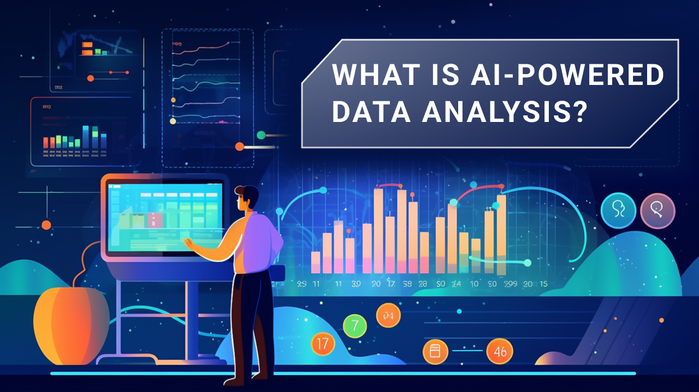
AI-Powered Collections Strategy
Leveraging Agentic AI for Scalable, Fair, and Effective Debt Management at Geldium

Slide 2
System Working
Workflow Chart
Customer Data Input: Customer Demographics, Repayment history, credit score, income, Loan_Balence.
Decision Logic Engine: The system uses Both— a combination of model predictions and defined business rules—to ensure decisions are efficient, accurate, and compliant.
Action Module: Subsidized financial coaching, job-seeking resource linkage,Automated SMS reminder before the next due date, Pre-approved debt consolidation offers or credit counseling referrals.
Learning Loop: Continuously refines decisions based on outcomes
Customer Data Input
Risk Prediction Engine
Personalized Action Model
Outcome Monitoring & Learning Loop

Slide 3
Role of Agentic AI
Autonomous AI
Predicting risk
Sending reminders
Adapting messages
Human Overview
Approving payment plans
Learning from the data
Reviewing edge cases
Handling disputes
Auditing fairness
Payment reminders
Deciding the risk tolerance

Slide 4
Responsible AI Guardrails
Fairness Checks: Detect and mitigate bias across segments.
Explainability: Clear, understandable decisions for customers.
Compliance: Meets regulatory standards like GDPR, ECOA.
Equal Opportunity Monitoring: The model should be equally effective at identifying both 'good' and 'bad' customers regardless of their group.
Human-in-the-Loop: Agents involved in critical decisions.

Slide 5
Expected Business Impact
Quantitative outcomes
Qualitative outcomes
Enhanced Customer Loyalty and Retention
Improved Regulatory and Ethical Standing
Strategic Resource Allocation
Improved customer trust
Optimized Capital Reserves
Reduced Loan Losses (Write-Offs)
Lower Cost of Collections
Increased repayment rates
Reduced delinquency
Cost savings
Better recovery rates
Enhanced fairness
Increased scalability

